Slide 1

Splunk Fundamentals
Data to Everything
Monitoring, Searching, and Visualizing Data

Slide 2
60-Minute Training Agenda
01
02
Introduction to Splunk
Architecture & Components
Platform overview and core concepts
System design and deployment modes
03
04
Data Ingestion & Sources
Search Processing Language
Methods for collecting and importing data
SPL basics and query examples
05
06
Dashboards & Alerts
Hands-on Examples
Visualization and monitoring tools
Practical demonstrations and Q&A

Slide 3
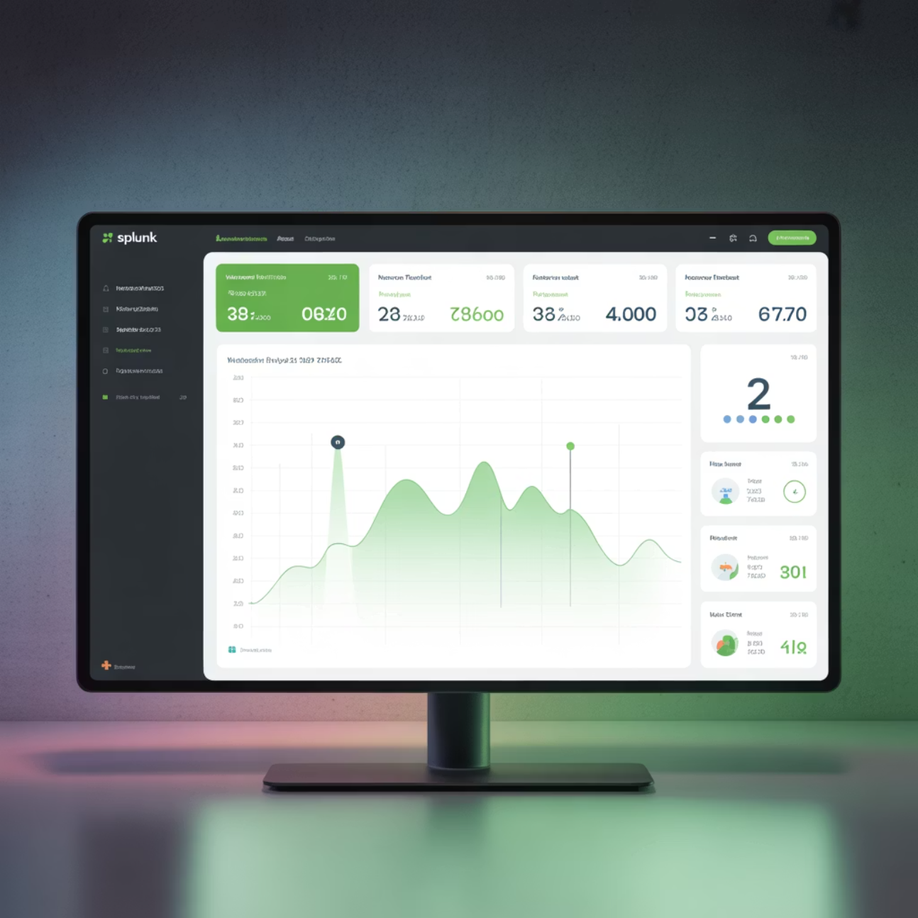
What is Splunk?
Splunk is a comprehensive platform for searching, monitoring, and analyzing machine data. It works seamlessly with structured, semi-structured, and unstructured data, making it invaluable for organizations dealing with massive amounts of information.
The platform transforms raw data into actionable insights, enabling businesses to make informed decisions based on real-time analytics and historical trends.
IT Operations
Security (SIEM)
Log analysis and troubleshooting
Threat detection and incident response
Business Analytics
Customer behavior and transactions

Slide 4


Real-World Use Case
Banking Security Example
A major bank uses Splunk to detect failed login attempts and alert security teams in real time. When suspicious activity is detected, automated alerts trigger immediate investigation protocols, preventing potential security breaches.
This example demonstrates how Splunk transforms raw security logs into actionable intelligence, enabling proactive threat detection and rapid response capabilities across enterprise environments.

Slide 5




Splunk Architecture Components
Forwarder
Indexer
Collects logs and sends data to indexer for processing
Stores and indexes data for fast search and retrieval
Search Head
Management
User interface for searching and visualization
Deployment Server and Cluster Master for scaling
Deployment Modes
Standalone
Distributed
Clustered
Perfect for small setups and testing environments
Separate indexers and search heads for better performance
High availability with redundancy and load balancing

Slide 6



Data Ingestion & Sources
Logs
Metrics
Events
Server logs, application logs, and system events provide detailed operational insights
System performance data, cloud monitoring metrics, and KPI measurements
Security events, audit trails, and compliance-related data streams
Ingestion Methods
Universal Forwarder (UF)
HTTP Event Collector
Lightweight agent for continuous data collection
REST API for direct data submission
Manual Upload
API Integrations
CSV/JSON file imports for batch processing
Third-party system connections

Slide 7


Apache Web Server Log Example
When uploading Apache Web Server logs into Splunk, the platform automatically extracts valuable fields including IP addresses, requested URLs, response codes, and timestamps. This structured approach enables rapid analysis of web traffic patterns and performance metrics.
Key Fields Extracted: IP Address, URL, Response Code, Timestamp, User Agent, Referrer

Slide 8





Search Processing Language (SPL)
SPL is Splunk's powerful query language for searching and analyzing data. Similar to SQL but optimized specifically for logs and events, SPL enables complex data analysis with intuitive commands.
search
stats
eval
Filter events based on criteria
Aggregate and summarize data
Create new calculated fields
timechart
where
Time-series visualization
Apply conditional filters
Sample SPL Queries
index=security sourcetype=linux_secure "Failed password"index=syslog | stats count by hostindex=web sourcetype=access_combined | timechart count by status

Slide 9
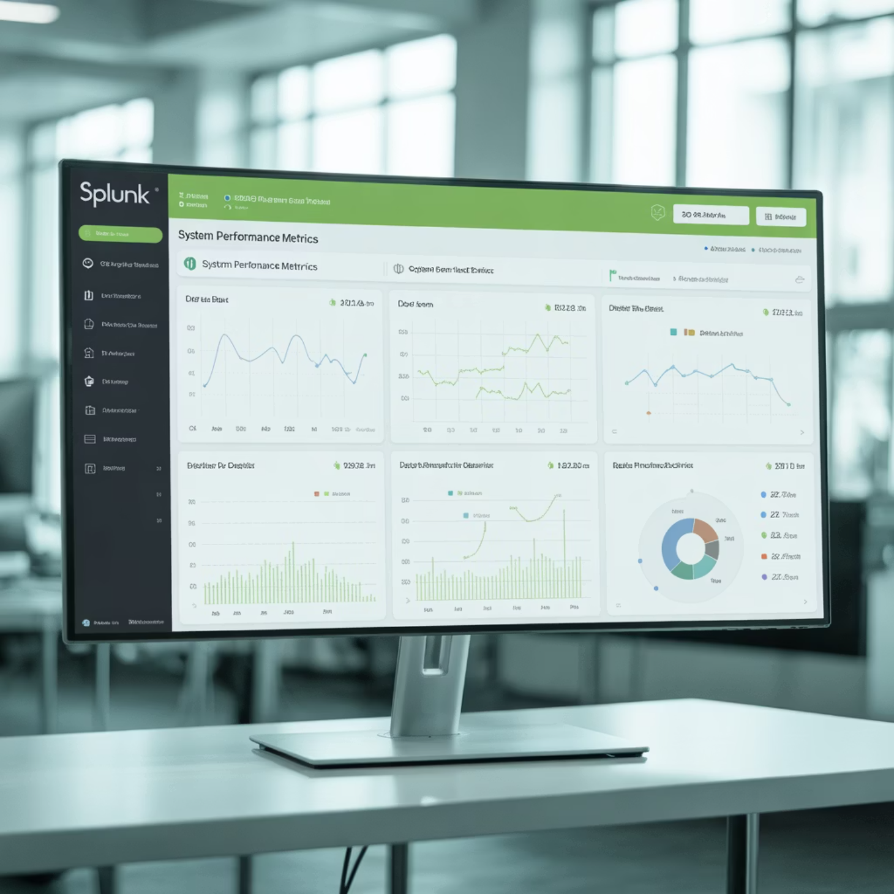

Dashboards, Reports & Alerts
Dashboards
Alerts & Reports
Combine multiple visualizations into comprehensive monitoring views. Real-time data updates provide instant insights into system performance and business metrics.
Automated notifications triggered by specific conditions. Reports can be scheduled and exported to various formats for stakeholder distribution.
Email Notifications
Instant alerts via email
Slack Integration
Team collaboration alerts
Webhook Support
Custom system integrations
Example Alert: Trigger when failed logins exceed 5 attempts within 1 minute - Dashboard showing top 10 IPs with failed login attempts

Slide 10

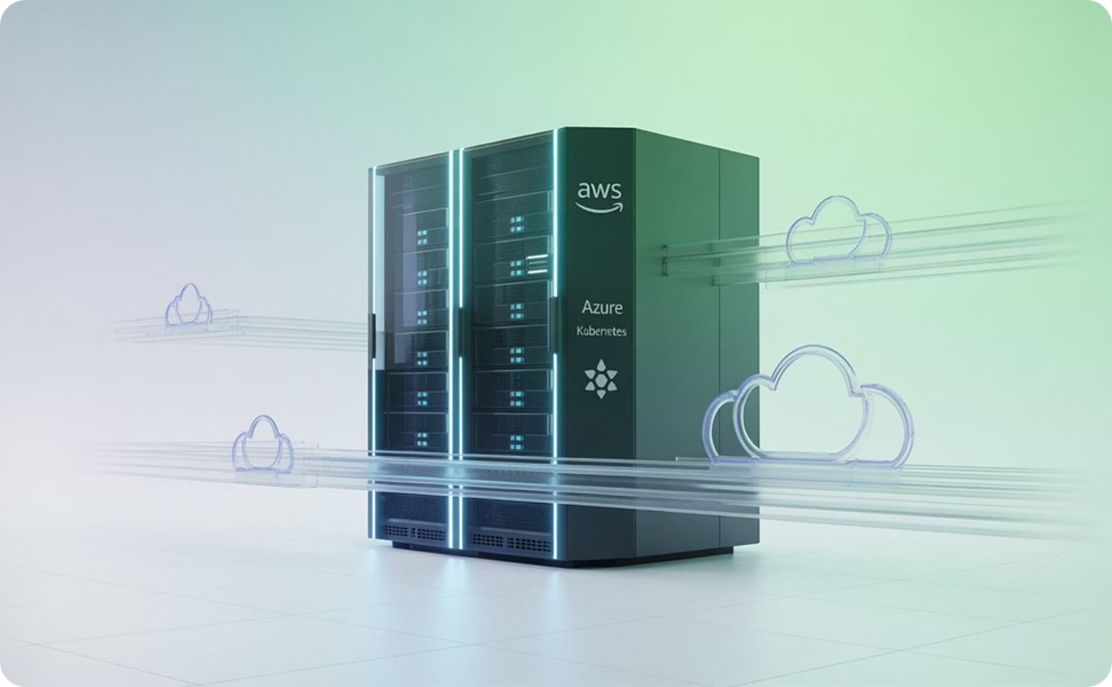
Advanced Features
Machine Learning Toolkit
Splunk Apps & Add-ons
Predict anomalies in logs and detect unusual patterns. Example: automatically identify abnormal CPU usage spikes that could indicate system issues or security threats.
Pre-built integrations for AWS, Azure, Kubernetes, and hundreds of other platforms. These apps provide ready-to-use dashboards and reports tailored for specific technologies.

Slide 11
Training Summary & Time Allocation
5
8
8
15
Introduction
Architecture
Data Ingestion
SPL Basics
Platform overview and use cases
Components and deployment
Sources and methods
Query language fundamentals
10
14
Dashboards
Advanced & Q&A
Visualization and alerts
ML features and discussion
Key Takeaways
Splunk transforms raw data into actionable insights through powerful search and analytics capabilities
SPL is the core language for searching, filtering, and reporting on machine data
Dashboards and alerts enable real-time monitoring and proactive incident response
Advanced features like machine learning and pre-built apps extend platform capabilities

Slide 12

Questions & Next Steps
Q&A
Ready to explore your specific use cases and implementation questions
Ready-to-Use Content
Hands-On Practice
All slides, diagrams, and sample queries formatted for immediate presentation use
Try the SPL examples with your own data sources and explore dashboard creation
Implementation Support
Contact for assistance with specific deployment scenarios and advanced configurations

